Slide 1
Research Update
2d Lt David Crow
Dr. Scott Graham

Slide 2
Overview
Study 1 (complete*)
Background
Experiments
Results
Conclusions
Study 2 (ongoing)
Background
Demonstrated capabilities
Thoughts going forward
*essentially

Slide 3
Study 1
Can deep learning tools effectively determine which
vehicle generated a given segment of data?

Slide 4
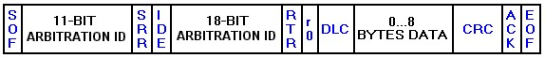
Controller Area Network

Slide 5
Methodology
For each of three disparate experiments:
Process the data
Iteratively evaluate deep learning models (MLP, CNN)
Re-evaluate the optimal models
Train/test using the full dataset
Train/test using a balanced dataset

Slide 6
Exp. 1: Ordered Data
Time
CAN packet
ArbID | … | Data
CAN packet
ArbID | … | Data
CAN packet
ArbID | … | Data
CAN packet
ArbID | … | Data
 | …
Data | Data | Data | Data | … | … | … | … | … | …
Input sample
1024 bytes

Slide 7
Exp. 2: Ordered ArbIDs
Time
CAN packet
ArbID | … | Data
CAN packet
ArbID | … | Data
CAN packet
ArbID | … | Data
CAN packet
ArbID | … | Data
 | …
ArbID | ArbID | ArbID | ArbID | … | … | … | … | … | …
Input sample
N = 128

Slide 8
Exp. 3: Unordered Data
Time
CAN packet
ArbID | … | Data
CAN packet
ArbID | … | Data
CAN packet
ArbID | … | Data
CAN packet
ArbID | … | Data
 | …
Data | Data | Data | Data | … | … | … | … | … | …
Input sample
1024 bytes

Slide 9
Results
Model | Dataset | Ordered Data Accuracy³ | Ordered ArbIDs Accuracy | Unordered Data Accuracy
MLP¹ | Imbalanced (full) | 94.46 % | 82.08 % | 59.26 %
MLP | Balanced | 67.48 % | 68.16 % | 42.04 %
CNN² | Imbalanced (full) | 99.64 % | 99.52 % | 98.83 %
CNN | Balanced | 95.63 % | 99.05 % | 75.22 %
 | Average | 89.30 % | 87.20 % | 68.84 %
¹Multilayer perceptron
²Convolutional neural network
³Balanced accuracy

Slide 10
Conclusions
Deep learning models can effectively fingerprint vehicles
Deeper analysis of CAN design choices and tendencies
Intruder can employ deep learning for personal gain
Model | Dataset | Ordered Data Accuracy | Ordered ArbIDs Accuracy | Unordered Data Accuracy
CNN | Imbalanced | 99.64 % | 99.52 % | 98.83 %
Notes:
Touch on limitations of the experiments/conclusions (e.g., small number of classes)

Slide 11
Study 1 ⟶ Study 2
Study 1 assumes we only have access to raw CAN data
Study 2 assumes we can extract time series from the data

Slide 12
Study 2
Can various empirical dynamic modeling (EDM) techniques
enable better analysis of a vehicle’s time series data?

Slide 13
Time Series
(a) Google stock price for 200 consecutive days; (b) Daily change in the Google stock price for 200 consecutive days; (c) Annual number of strikes in the US; (d) Monthly sales of new one-family houses sold in the US; (e) Annual price of a dozen eggs in the US (constant dollars); (f) Monthly total of pigs slaughtered in Victoria, Australia; (g) Annual total of lynx trapped in the McKenzie River district of north-west Canada; (h) Monthly Australian beer production; (i) Monthly Australian electricity production.

Slide 14
Empirical Dynamic Modeling

Slide 15
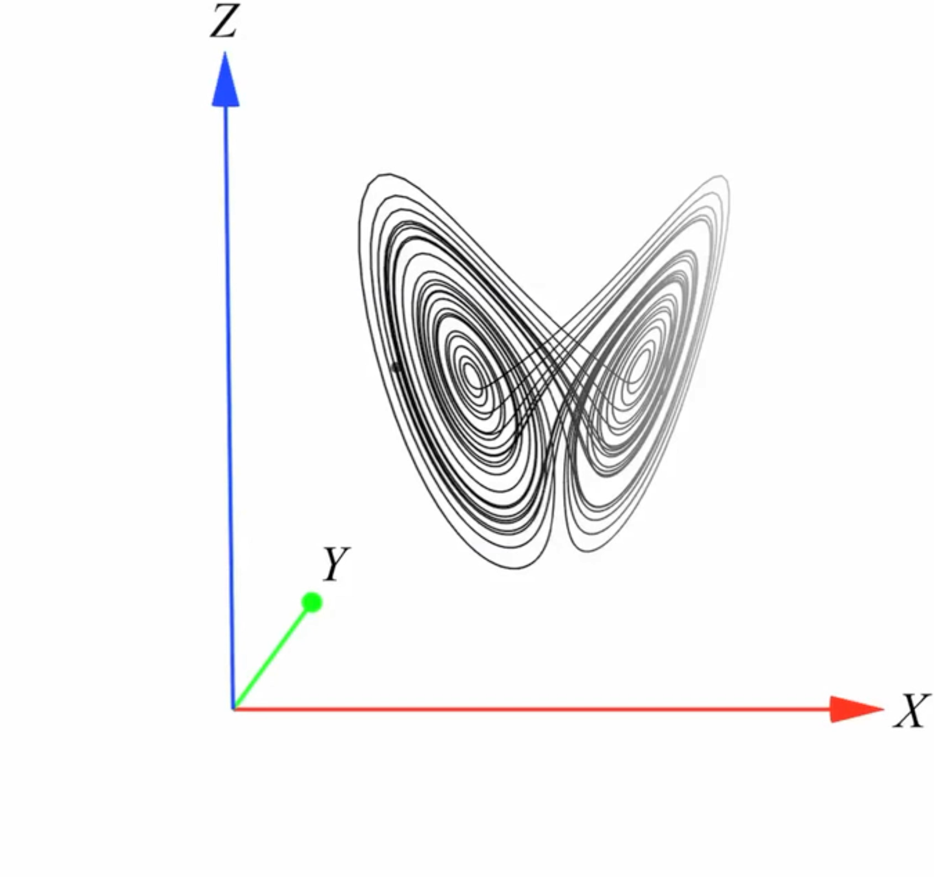
Empirical Dynamic Modeling
Analyze the state space
Predict time series
Identify deterministic chaos
Characterize nonlinearity
Detect causality
2
1
4
3
5

Slide 16
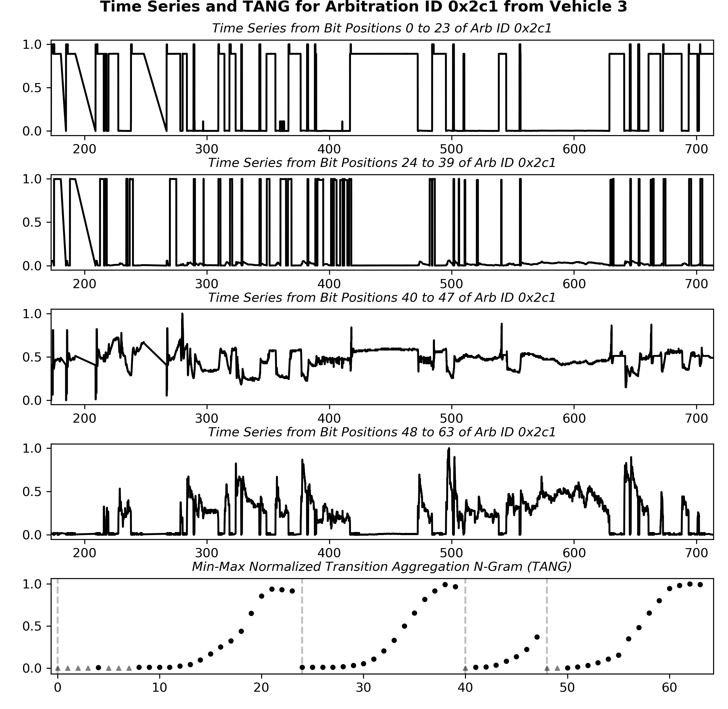
Reverse Engineering Pipeline
Notes:
Mention that EDM should apply to any CPS (e.g., planes)

Slide 17
Demonstrated Capabilities

Slide 18
Demonstrated Capabilities

Slide 19
Demonstrated Capabilities

Slide 20
Demonstrated Capabilities

Slide 21
Going Forward
Collect more simulated flight data
Ensure better understanding of implications of EDM
Identify states present in a system (e.g., takeoff, stall)?
Apply EDM methodology to further analyze CAN data*
Reach: establish preliminary intrusion detection system
*time series labels required for causality detection
Notes:
Third bullet: this should help in reverse engineering

Slide 22
Questions/Concerns

